Slide 1
EE 74099 / EN 74099 Research Project
Project Title: Vision Based Navigation System for Indoor Robots
Progress Presentation – 5
16.05.2019
Under the Supervision of : Dr. WGCW Kumara
And Eng. Abdul Cadar
Team Members:
ANFM. Begum - SEU/IS/13/EG/002
GSU. Ahmadh - SEU/IS/13/EG/011
IIS. Prema Sri - SEU/IS/13/EG/032

Slide 2
Design for the robot
Detection and tracking of the robot
1
2

Slide 3
Design for the robot…

Slide 4
Robot chassis design
The design we choose should be able to hold electronics components such as microcontrollers, sensors, battery and hold food we need to deliver.
One of the easiest designs to satisfy these requirements is TurtleBot, which has kind of table-like design.

Slide 5
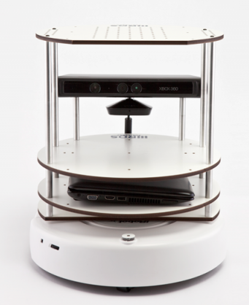
It has three layers in the chassis.
A robot platform called Roomba is the drive mechanism of this platform.
We are planning to design a robot similar to this with our own moving platform and components.
Moving platform will be designed as a differential drive system.

Slide 6
Tracking of Robot
Using Object Detection

Slide 7
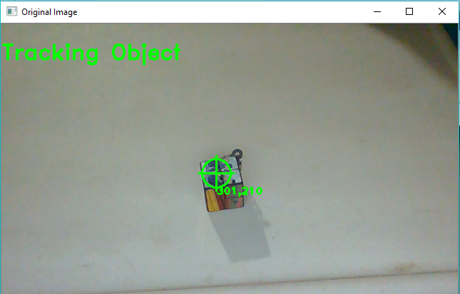
Tracking of Robot
For the navigation of the robot, we need two things.
Object Detection : To identify the current position of the robot
Tracking the path : To track the movements of robot to make sure it is aligned to the commands that being sent to it to reach the target destination.

Slide 8
1. Object Detection
We need to use object detection in our project to achieve two things.
Get the location of the robot in the map to help localize robot in the environment.
Identify people in the environment to decide on the best path for the robot to reach the destination.
At first step, we are planning to start working on identifying robot in a video feed and get the location in the image. And the detection of the moving objects will be proceeded later on the course.

Slide 9
1. Object Detection
For Object detection,
Currently we are experimenting with different methods.
Deep learning based object detection is the first one that we are going to go with.
In order to do the detection, we need to train a neural network with many images of the robot to identify it on the image feed.
As we currently don’t have a robot we thought to go with a simulation images to train it and to test the detection and hence the tracking in the video generated from the simulation.

Slide 10
To achieve real-time object detection, we’ll need to..
Access video stream in an efficient manner.
Apply object detection to each frame.
Accessing video stream is possible with OpenCV.
To achieve object detection, we need to train an image classifier.
Then we can use trained classifier to detect objects in an image, and to track them across a video.

Slide 11
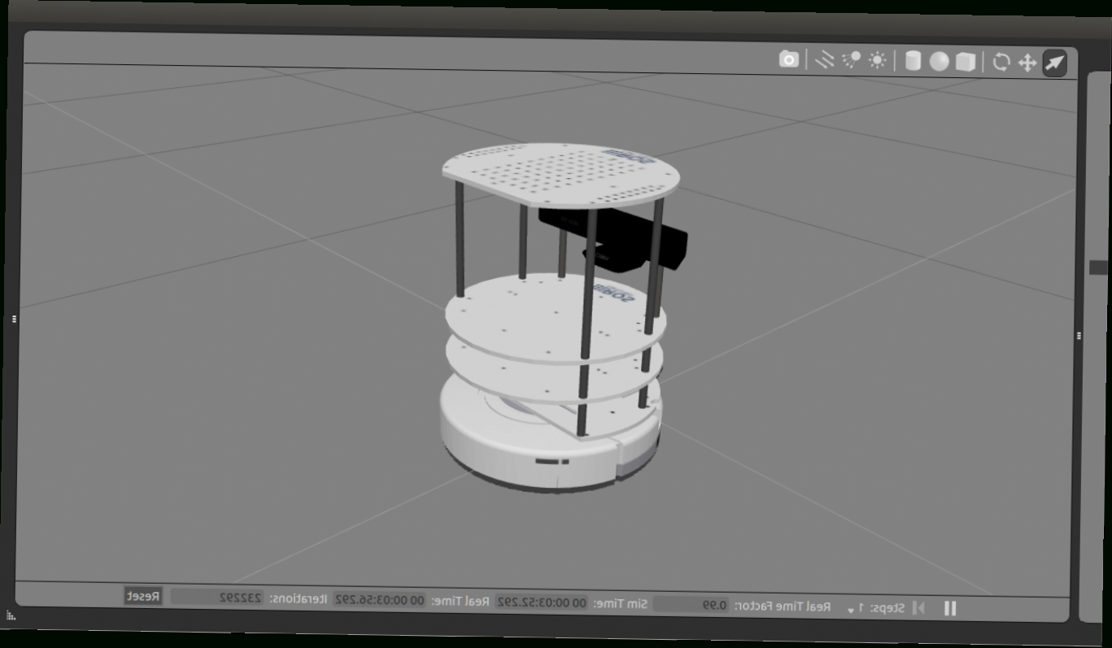
we are going to test an image classifier with the images we have from simulation model for the TurtleBot robot from Gazebo robotics simulator.

Slide 12
Next Week…

Slide 13
Next Week
We will be working on training a neural network with images gathered from the simulation environment.
After successfully completing the training, we will then work on integrating the detection to OpenCV to get the coordinates of the robot on the image.
Then, converting the image coordinates to world coordinates using our previously done works. So that we will have a tracking on a 2D map.

Slide 14
Thank You

